Slide 1
Prospect HS
Math Department
PTSA Meeting October 10th, 2017

Slide 2
Overview
CPM
PDs and Collaborations
Philosophy
Progression
Parents to work on a student activity
Demo
Parent Guide & Resources
Next step

Slide 3
Updates
Each IM teacher attended three day PDs before the implementation.
Four full-day PDs scheduled for this school year.
Each IM level’s team lead organizes collaborations as needed and shares common resources with each other.

Slide 4
Current Team Leaders
IM1: Mr. McGowan
IM2: Ms. Murch
IM3/STEM: Ms. Peck
AP & others: Ms. Shoenhair

Slide 5
CPM philosophy
Group activity with assigned roles
Exploratory problems
Review & Preview

Slide 6
IM1:
Chapter 1: Functions
Chapter 2: Linear Functions
Chapter 3: Transformations and Solving
Chapter 4: Modeling Two-Variable Data
Chapter 5: Sequences
Chapter 6: Systems of Equations
Chapter 7: Congruence and Coordinate Geometry
Chapter 8: Exponential Functions
Chapter 9: Inequalities
Chapter 10: Functions and Data
Chapter 11: Constructions and Closure
IM2:
Chapter 1: Exploring Algebraic and Geometric Relationships
Chapter 2: Justification and Similarity
Chapter 3: Probability and Trigonometry
Chapter 4: Factoring and More Trigonometry
Chapter 5: Quadratic Functions
Chapter 6: More Right Triangles
Chapter 7: Proof and Conditional Probability
Chapter 8: Polygons and Circles
Chapter 9: Modeling with Functions
Chapter 10: Circles and More
Chapter 11: Solids
Chapter 12: Counting and Closure
IM3/STEM:
Chapter 1: Investigations and Functions
Chapter 2: Transformations of Parent Graphs
Chapter 3: Solving and Inequalities
*Chapter 4: Normal Distributions and Geometric Modeling
Chapter 5: Inverses and Logarithms
*Chapter 6: Simulating Sampling Variability
Chapter 7: Logarithms and Triangles
Chapter 8: Polynomials
Chapter 9: Trigonometric Functions
Chapter 10: Series
Chapter 11: Rational Expressions and Three-Variable Systems
Chapter 12: Analytic Trigonometry
* Not covered in STEM. STEM has additional topics: Trig equations; Sinusoids; Expanded Trig Equations

Slide 7
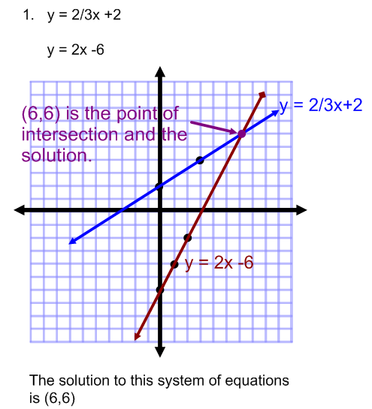
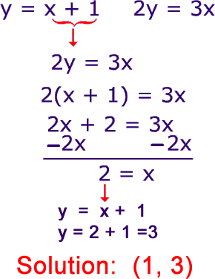
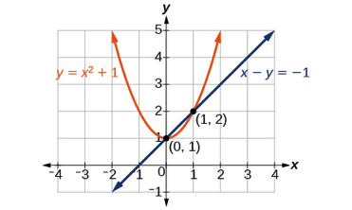
IM1/2/3/STEM Progression
Example of System of Equations
IM1:Solve by graphing
IM2: Solve by algebra
IM3/STEM: Find intersections of non-linear systems

Slide 8
Student Activity
Parents to form teams (Each group consists of four adults)
Please turn off your cellphone and put it in your purse/backpack
Discuss and decide each member’s duty
Pick up the packet and required resources
Work and finish the activity (IM1 Problem 2-24) in 10 minutes

Slide 9
Live Demo: CPM Parent Resources
1. CPM Homework Help
https://homework.cpm.org/cpm-homework/
2. CPM Parent Guide with extra practices
Student ebook → Reference → Student Support → Parent Guide with Extra Practice

Slide 10
Live Demo: CPM Parent Resources
https://drive.google.com/open?id=0B8loS88espWHb2d2VEdSR0szWURSWlFQc2VxUEFNc0tRLUpr

Slide 11
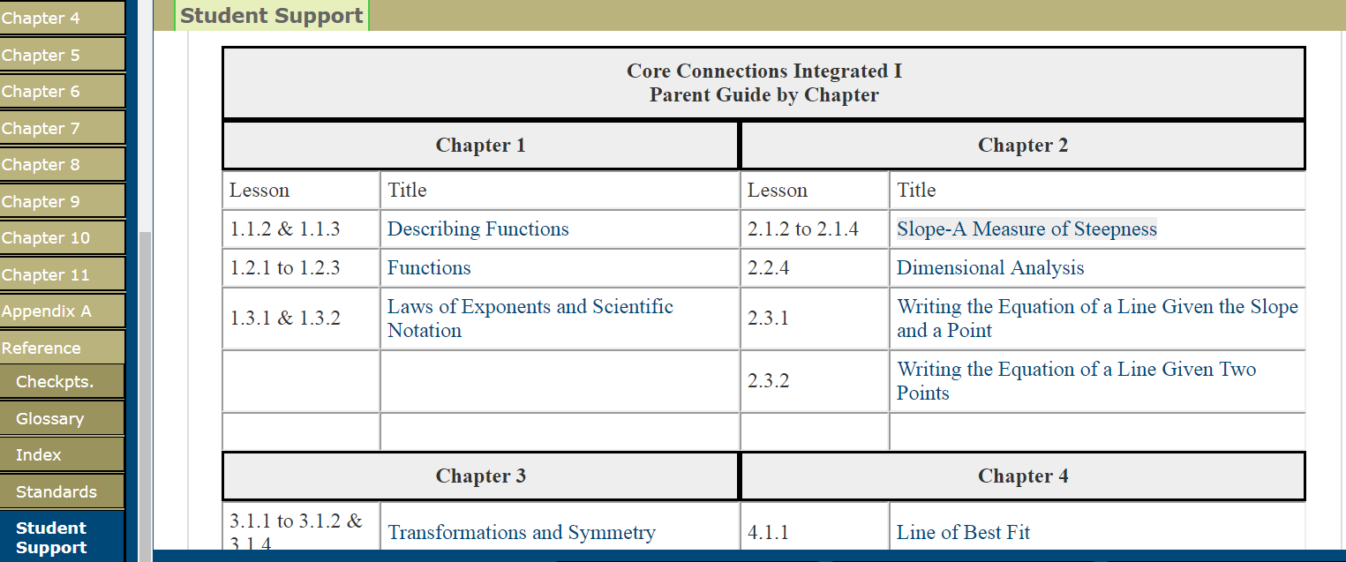

Slide 12
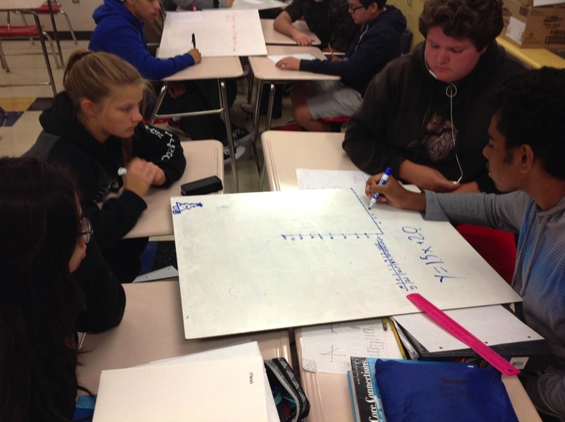
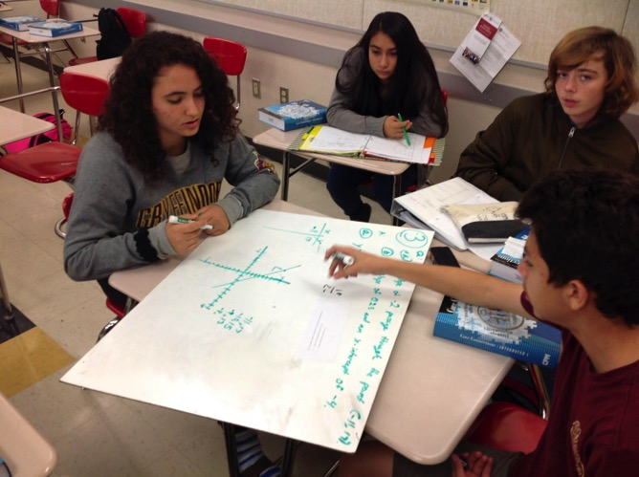
Students work as a team on problem solving

Slide 13
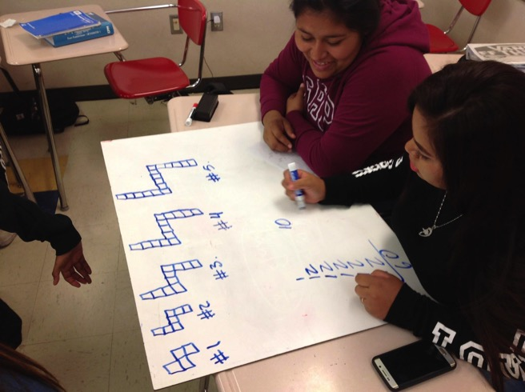
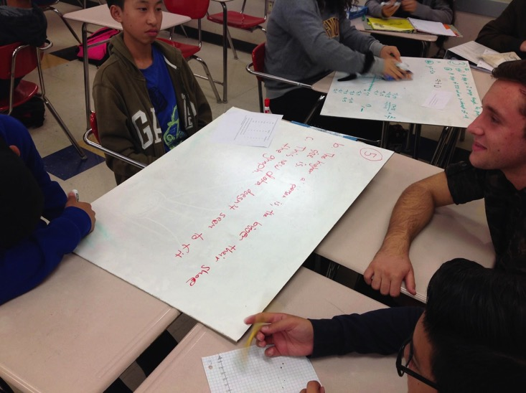

Slide 14
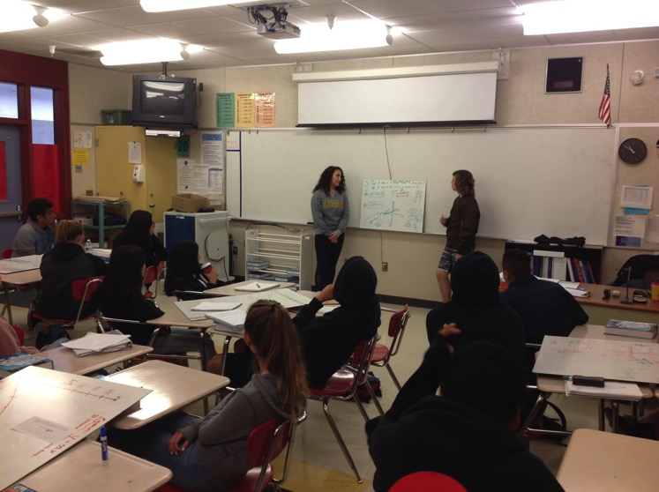
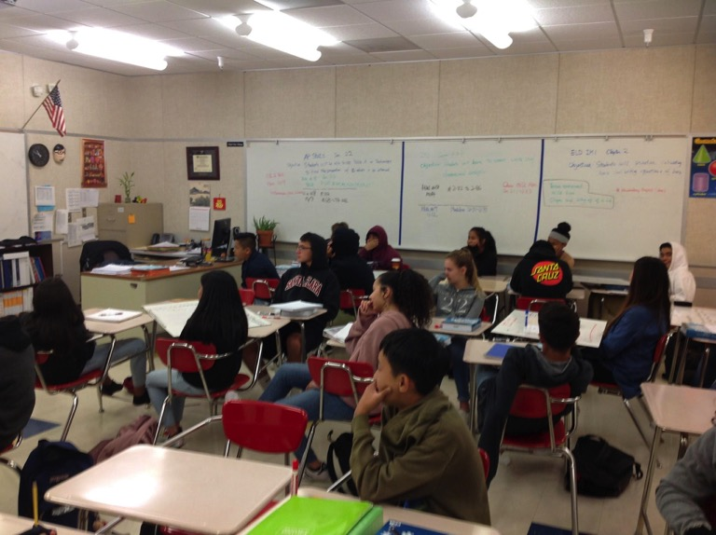
Student presentation

Slide 15
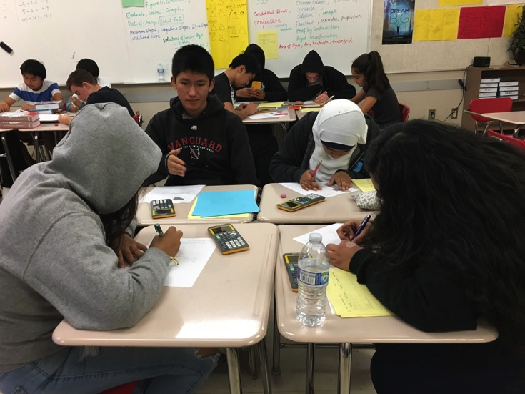
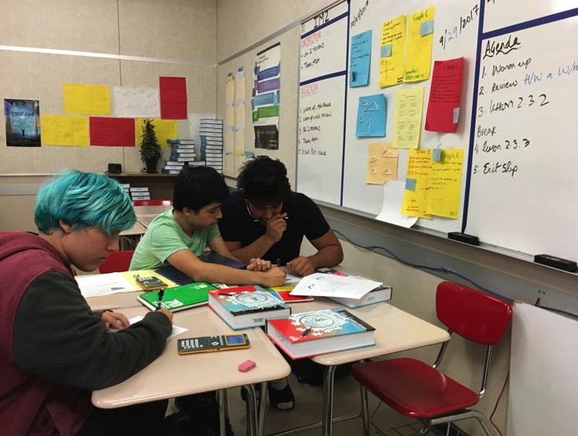
Group work - using technology

Slide 16
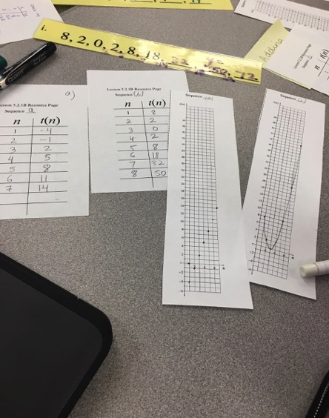
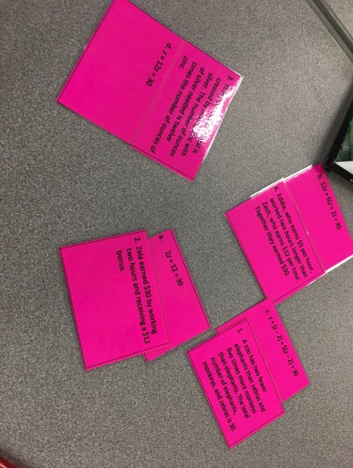
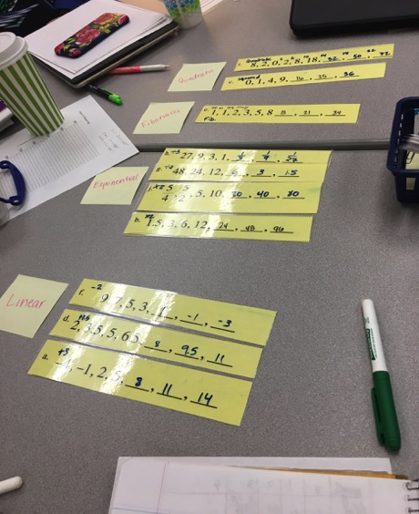
Group Activities - Sorting & graphing

Slide 17
Next Step
Strengthen IM3 STEM
Pilot IM4

